Slide 1
Chapter 3: Advanced Computer Hardware
Instructor Materials
IT Essentials v7.0
Notes:
Cisco Networking Academy Program
IT Essentials v7.0
Chapter 3: Advanced Computer Hardware

Slide 2
Instructor Materials – Chapter 3 Planning Guide
This PowerPoint deck is divided in two parts:
Instructor Planning Guide
Information to help you become familiar with the chapter
Teaching aids
Instructor Class Presentation
Optional slides that you can use in the classroom
Begins on slide #13
Note: Remove the Planning Guide from this presentation before sharing with anyone.
Notes:
2

Slide 3
Chapter 3: Advanced Computer Hardware
IT Essentials 7.0 Planning Guide
Notes:
Cisco Networking Academy Program
IT Essentials v7.0
Chapter 3: Advanced Computer Hardware

Slide 4
Check Your Understanding and What Do You Already Know?
Check Your Understanding activities used to be called Interactive Activities. They simply have a new name. They are designed to let students quickly determine if they understand the content and can proceed, or if they need to review.
Check Your Understanding activities do not affect student grades.
Activities listed as What Do You Already Know? are a type of activity in which we ask the student to simply take a guess! It is not meant to evaluate their knowledge. It is only meant to give them a head start in thinking about different topics before they are presented in the course. Students receive addition content in the form of feedback for any answers they select.
What Do You Already Know? activities do not directly affect student grades; however, the feedback may contain content which appears later in quizzes and exams, so it is important that students complete the What Do You Already Know? activities.
There are no separate slides for these activities in the PPT. They are listed in the notes area of the slide that appears before these activities.
Notes:
4

Slide 5
Chapter 3: Activities
What activities are associated with this chapter?
Page # | Activity Type | Activity Name | Optional?
3.1.1.1 | Video Demonstration | BIOS - UEFI Menus | Recommended
3.1.1.5 | Check Your Understanding | BIOS and UEFI Terminology | Recommended
3.1.1.6 | Lab | Investigate BIOS or UEFI Settings | Recommended
3.1.2.1 | Video Demonstration | Configure BIOS – UEFI Settings | Recommended
3.1.2.4 | Check Your Understanding | BIOS and UEFI Configuration Terminology | Recommended
3.1.2.5 | Lab | Search for BIOS or UEFI Firmware Updates | Recommended
3.1.2.6 | Lab | Install Windows | Recommended
3.1.2.7 | Lab | Install Third-Party Software in Windows | Recommended
3.2.1.3 | Lab | Ohm’s Law | Recommended
3.2.2.3 | Check Your Understanding | Power Fluctuation Terms | Recommended
3.3.1.5 | Check Your Understanding | CPU Architectures and Operation | Recommended
Notes:
5

Slide 6
Chapter 3: Activities (Cont.)
What activities are associated with this chapter?
Page # | Activity Type | Activity Name | Optional?
3.3.2.1 | What Do You Already Know? | RAID | Recommended
3.3.2.4 | Check Your Understanding | RAID | Recommended
3.3.3.8 | Check Your Understanding | Ports, Connectors, and Cables | Recommended
3.3.4.5 | Check Your Understanding | Monitor Terminology | Recommended
3.4.1.7 | Lab | Research a Hardware Upgrade | Recommended
3.4.2.1 | What Do You Already Know? | Configure a CAx Workstation | Recommended
3.4.2.2 | What Do You Already Know? | Configure an Audio Video Editing Workstation | Recommended
3.4.2.3 | What Do You Already Know? | Configure a Virtualization Workstation | Recommended
3.4.2.4 | What Do You Already Know? | Configure a Gaming PC | Recommended
3.4.2.5 | Check Your Understanding | Specialized Computer Component Types | Recommended
3.5.1.3 | Check Your Understanding | Safe Disposal | Recommended
Notes:
6

Slide 7
Chapter 3: Assessment
Students should complete Chapter 3, “Assessment” after completing Chapter 3.
Quizzes, labs, Packet Tracers and other activities can be used to informally assess student progress.
Notes:
7

Slide 8
Chapter 3: Best Practices
Prior to teaching Chapter 3, the instructor should:
Complete Chapter 3, “Assessment.”
The objectives of this chapter are:
Describe POST, BIOS, CMOS and UEFI.
Configure the computer firmware.
Describe wattage and voltage.
Explain power fluctuations and devices that protect against damage caused by fluctuations.
Explain CPU architecture.
Describe RAID.
Describe common ports, cables, and connectors.
Describe monitor characteristics.
Select appropriate components to upgrade a computer.
Select components for specialized computers.
Explain safe disposal methods.
Notes:
8

Slide 9
Chapter 3: Best Practices (Cont.)
Ensure this chapter becomes as hands-on as possible.
Demonstrate and explore with the students the configuration and settings within UEFI/BIOS. Consider doing Activity 3.2.2.7 with the class after the demonstration.
When assembling computers, it is crucial to understand that force should never be used; connectors are designed to connected smoothly.
It is crucial to remember that while the voltages are low, components are extremely sensitive to ESD and voltage variations.
Make sure students understand that some connector pins carry power and should always be connected correctly.
Special attention should be payed when installing CPUs; the pin 1 is clearly indicated on the chip and on the motherboard but due the format factor, CPUs are not keyed and can be easily damaged by incorrect installation.
Be sure to emphasize the importance of working with cables. Don’t force a cable in. Check orientation. Pull using the edges of the connector, not the cable. Look for locking mechanisms if working on a mobile device.
Notes:
9

Slide 10
Chapter 3: Best Practices (Cont.)
Consider doing the 3.1.2.5 activity as a class activity before disassembly/reassembly.
For the entire upgrade section, scenarios are a fun way to allow the students to pretend to go shopping for the upgrade. The scenarios do not have to be complex and each student or pair of students can have a different one with sharing at the end. Example: A person with 2 GBs of RAM wants to upgrade their memory. Currently the computer has two 1GB sticks and 4 expansion slots. What recommendation would you make for this person? Other topics include a second hard drive, adding a video card, changing the keyboard and mouse to one more suited for someone with sever arthritis, upgrading the CPU, and providing more cooling for the computer.
Notes:
10

Slide 11
Chapter 3: Additional Help
For additional help with teaching strategies, including lesson plans, analogies for difficult concepts, and discussion topics, visit the ITE Community at: https://www.netacad.com/group/communities/community-home
Best practices from around the world for teaching IT Essentials. https://www.netacad.com/group/communities/it-essentials
If you have lesson plans or resources that you would like to share, upload them to the ITE Community in order to help other instructors.
Students can enroll in Introduction to Packet Tracer (self-paced).
Notes:
11

Slide 13
Chapter 3: Advanced Computer Hardware
IT Essentials v7.0
Notes:
Cisco Networking Academy Program
IT Essentials v7.0
Chapter 3: Advanced Computer Hardware

Slide 14
Chapter 3 - Sections & Objectives
3.1 Boot the Computer
Configure BIOS and UEFI Settings
Describe POST, BIOS, CMOS and UEFI.
Configure the computer firmware.
3.2 Electrical Power
Explain electrical power
Describe wattage and voltage.
Explain power fluctuations and devices that protect against damage caused by fluctuations.
Notes:
14
Cisco Networking Academy Program
IT Essentials v7.0
Chapter 3: Advanced Computer Hardware

Slide 15
Chapter 3 - Sections & Objectives (Cont.)
3.3 Advanced Computer Functionality
Explain computer functionality
Explain CPU architecture.
Describe RAID.
Describe common ports, cables, and connectors.
Describe monitor characteristics.
3.4 Computer Upgrade
Select components to upgrade a computer to meet requirements
Select appropriate components to upgrade a computer.
Select components for specialized computers.
3.5 Protecting the Environment
Explain safe disposal methods to protect the environment
Explain safe disposal methods.
Notes:
15
Cisco Networking Academy Program
IT Essentials v7.0
Chapter 3: Advanced Computer Hardware

Slide 16
3.1 Boot the Computer
Notes:
3 – Advanced Computer Hardware
3.1 – Boot the Computer

Slide 17
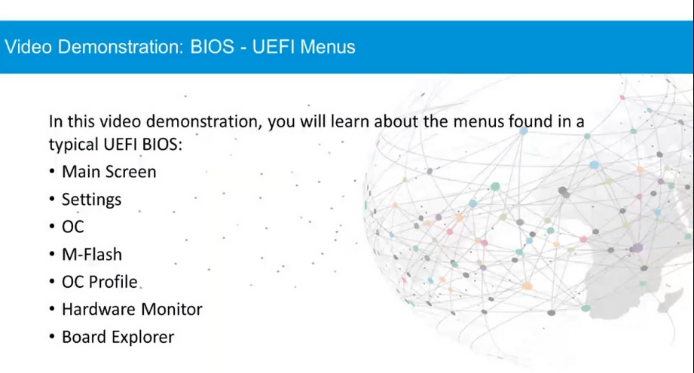
POST, BIOS, CMOS and UEFI Video Demonstration – BIOS – UEFI Menus
Notes:
3.1 – Boot the Computer
3.1.1 – POST, BIOS, CMOS and UEFI
3.1.1.1 – Video Demonstration – BIOS – UEFI Menus

Slide 18
POST, BIOS, CMOS and UEFI POST
When a computer is booted, the basic input/output system (BIOS) performs a hardware check on the main components of the computer.
This check is called a power-on self-test (POST).
If a device is malfunctioning, an error or a beep code alerts the technician of the problem.
BIOS manufacturers use different codes to indicate different hardware problems.
Motherboard manufacturers may use different beep codes.
Always consult the motherboard documentation to get the beep codes for your computer.
Installation Tip: To determine if POST is working properly, remove all of the RAM modules from the computer and power it on.
The computer should emit the beep code for a computer with no RAM installed.
This will not harm the computer.
Notes:
3.1 – Boot the Computer
3.1.1 – POST, BIOS, CMOS and UEFI
3.1.1.2 – POST

Slide 19
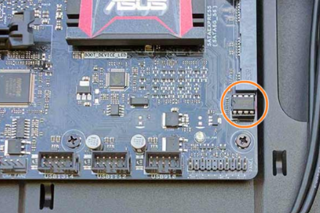
POST, BIOS, CMOS and UEFI BIOS and CMOS
All motherboards need a BIOS to operate.
BIOS is a ROM chip on the motherboard that contains a small program that controls the communication between the operating system and the hardware.
Along with the POST, BIOS also identifies:
Which drives are available
Which drives are bootable
How the memory is configured and when it can be used
How PCIe and PCI expansion slots are configured
How SATA and USB ports are configured
Motherboard power management features
Notes:
3.1 – Boot the Computer
3.1.1 – POST, BIOS, CMOS and UEFI
3.1.1.3 – BIOS and CMOS

Slide 20
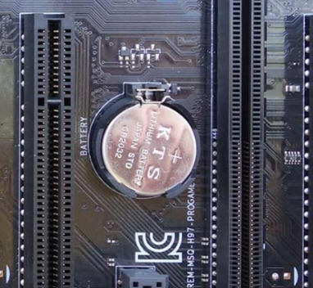
POST, BIOS, CMOS and UEFI BIOS and CMOS (Cont.)
The motherboard manufacturer saves the motherboard BIOS settings in a Complementary Metal Oxide Semiconductor (CMOS) memory chip.
When a computer boots, the BIOS software reads the configured settings stored in CMOS to determine how to configure the hardware.
The BIOS settings are retained by CMOS using a battery.
If the battery fails, important settings can be lost.
Installation Tip: If the computer’s time and date are incorrect, it could indicate that the CMOS battery is bad or is getting very low.
Notes:
3.1 – Boot the Computer
3.1.1 – POST, BIOS, CMOS and UEFI
3.1.1.3 – BIOS and CMOS

Slide 21
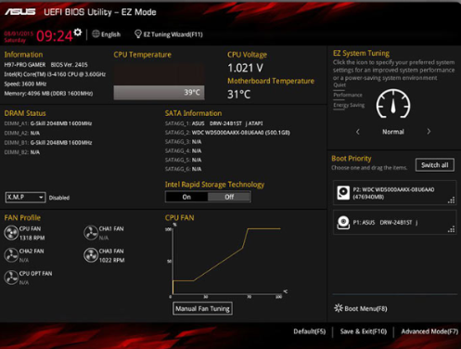
POST, BIOS, CMOS and UEFI UEFI
Most computers today run Unified Extensible Firmware Interface (UEFI).
All new computers come with UEFI, which provides additional features and addresses security issues with legacy BIOS.
UEFI can run on 32-bit and 64-bit systems, supports larger boot drives, and includes additional features such as secure boot.
Secure boot ensures your computer boots to your specified operating system.
This helps prevent rootkits from taking over the system.
Notes:
3.1 – Boot the Computer
3.1.1 – POST, BIOS, CMOS and UEFI
3.1.1.4 – UEFI
3.1.1.5 – Check Your Understanding - BIOS and UEFI Terminology

Slide 22
POST, BIOS, CMOS and UEFI Lab – Investigate BIOS or UEFI Settings
In this lab, you will boot the computer, explore the firmware setup utility program, and change the boot order sequence.
Part 1: Enter BIOS or UEFI
Part 2: Explore the Settings
Notes:
3.1 – Boot the Computer
3.1.1 – POST, BIOS, CMOS and UEFI
3.1.1.6 – Lab – Investigate BIOS or UEFI Settings

Slide 23
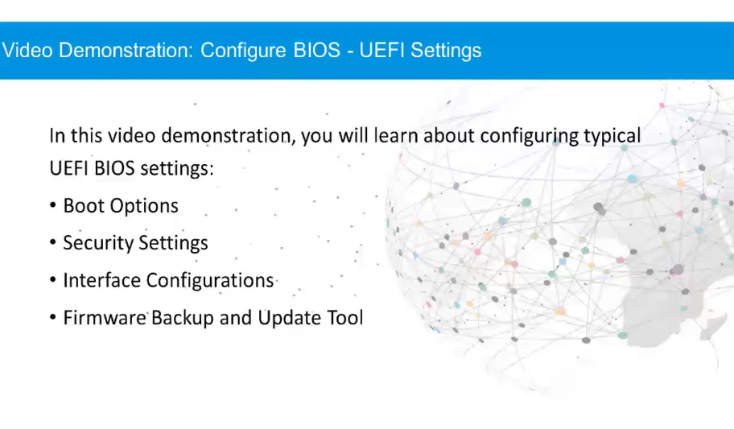
BIOS/UEFI Configuration Video Demonstration – Configure BIOS – UEFI Settings
Notes:
3.1 – Boot the Computer
3.1.2 – BIOS/UEFI Configuration
3.1.2.1 – Video Demonstration – Configure BIOS – UEFI Settings

Slide 24
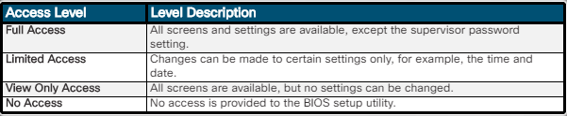
BIOS/UEFI Configuration BIOS and UEFI Security
The legacy BIOS supports some security features to protect the BIOS setting, however UEFI adds additional security features.
Some common security features found in the BIOS/UEFI systems includes:
Passwords - Passwords allow for different levels of access to the BIOS settings.
Drive encryption - A hard drive can be encrypted to prevent data theft.
LoJack – This is a security feature that allows the owner to locate, lock, and delete the device.
Trusted Platform Module (TPM) – This is a chip designed to secure hardware by storing encryption keys, digital certificates, passwords, and data.
Secure boot - Secure Boot is a UEFI security standard that ensures that a computer only boots an OS that is trusted by the motherboard manufacturer.
Notes:
3.1 – Boot the Computer
3.1.2 – BIOS/UEFI Configuration
3.1.2.2 – BIOS and UEFI Security

Slide 25
BIOS/UEFI Configuration Update the Firmware
Motherboard manufacturers may publish updated BIOS versions to provide enhancements to system stability, compatibility, and performance.
Early computer BIOS information was contained in ROM chips and to upgrade the BIOS information, the ROM chip had to be physically replaced.
Modern BIOS chips are Electronically Erasable Programmable Read Only Memory (EEPROM) which can be upgraded by the user without opening the computer case.
This is called “flashing the BIOS”.
To download a new BIOS, consult the manufacturer’s website and follow the recommended installation procedures.
Notes:
3.1 – Boot the Computer
3.1.2 – BIOS/UEFI Configuration
3.1.2.3 – Update the Firmware
3.1.2.4 – Check Your Understanding – BIOS and UEFI Configuration Terminology

Slide 26
BIOS/UEFI Configuration Lab – Search for BIOS or UEFI Firmware Updates
In this lab, you will identify the current BIOS or UEFI version and then search for BIOS or UEFI update files.
Notes:
3.1 – Boot the Computer
3.1.2 – BIOS/UEFI Configuration
3.1.2.5 – Lab – Search for BIOS or UEFI Firmware Updates

Slide 27
BIOS/UEFI Configuration Lab – Install Windows
In this lab, you will install Windows 10.
Notes:
3.1 – Boot the Computer
3.1.2 – BIOS/UEFI Configuration
3.1.2.6 – Lab – Install Windows

Slide 28
BIOS/UEFI Configuration Lab – Install Third-Party Software in Windows
In this lab, you will install and remove a third-party software application supplied by your instructor. You will install the Packet Tracer Windows application.
Notes:
3.1 – Boot the Computer
3.1.2 – BIOS/UEFI Configuration
3.1.2.7 – Lab – Install Third-Party Software in Windows

Slide 29
3.2 Electrical Power
Notes:
3 – Advanced Computer Hardware
3.2 – Electrical Power

Slide 30
Wattage and Voltage Wattage and Voltage
There are four basic units of electricity that a computer technician must know:
Voltage (V) – Measured in Volts (V) – The measure of work required to move a charge.
Current (I) – Measured in Amperes(A) – The measure of the amount of electrons moving through a circuit per second.
Resistance (R) – Measured in Ohms (O) – Refers to the opposition to the flow of current in a circuit.
Power (P) – Measured in Watts (W) –The measure of the work required to move electrons through a circuit multiplied by the # of electrons going through the circuit per second.
A basic equation, known as Ohm's Law, expresses how voltage is equal to the current multiplied by the resistance: V = IR.
In an electrical system, power is equal to the voltage multiplied by the current: P = VI.
Notes:
3.2 – Electrical Power
3.2.1 – Wattage and Voltage
3.2.1.1 – Wattage and Voltage

Slide 31
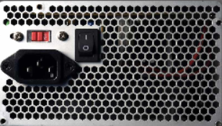
Wattage and Voltage Power Supply Voltage Settings
On the back of some power supplies is a small switch called the voltage selector switch.
This switch sets the input voltage to the power supply to either 110V / 115V or 220V / 230V.
A power supply with this switch is called a dual voltage power supply.
If a power supply does not have this switch, it automatically detects and sets the correct voltage.
The correct voltage setting is determined by the country where the power supply is used.
Notes:
3.2 – Electrical Power
3.2.1 – Wattage and Voltage
3.2.1.2 – Power Supply Voltage Settings

Slide 32
Wattage and Voltage Lab – Ohm’s Law
In this lab, you will answer questions based on electricity and Ohm’s Law.
Notes:
3.2 – Electrical Power
3.2.1 – Wattage and Voltage
3.2.1.3 – Lab – Ohm’s Law

Slide 33
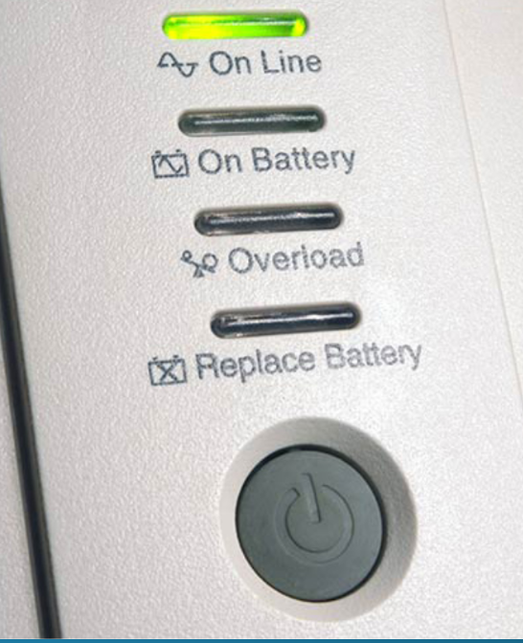
Power Fluctuation and Protection Power Fluctuation Types
When the voltage in a computer is not accurate or steady, computer components might not operate correctly.
The following types of AC power fluctuations can cause data loss or hardware failure:
Blackout - Complete loss of AC power.
Brownout - Reduced voltage level of AC power that lasts for a period of time.
Noise - Interference from generators and lightning.
Spike - Sudden increase in voltage that lasts for a short period and exceeds 100 percent of the normal voltage on a line.
Power surge - Dramatic increase in voltage above the normal flow of electrical current.
Notes:
3.2 – Electrical Power
3.2.2 – Power Fluctuation and Protection
3.2.2.1 – Power Fluctuation Types

Slide 34
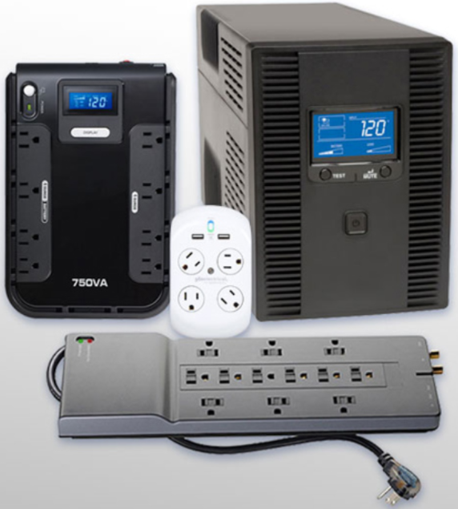
Power Fluctuation and Protection Power Protection Devices
To help shield against power fluctuation problems, use devices to protect the data and computer equipment:
Surge protector - Helps protect against damage from surges and spikes.
A surge suppressor diverts extra electrical voltage that is on the line to the ground.
Uninterruptible power supply (UPS) - Helps protect against potential electrical power problems and provides a consistent quality of power when brownouts and blackouts occur.
Standby power supply (SPS) - Helps protect against potential electrical power problems by providing a backup battery that is on standby during normal operation.
This device is not as reliable as a UPS because of the time it takes to switch over to the battery.
Notes:
3.2 – Electrical Power
3.2.2 – Power Fluctuation and Protection
3.2.2.2 – Power Protection Devices
3.2.2.3 – Check Your Understanding – Power Fluctuation Terms

Slide 35
3.3 Advanced Computer Functionality
Notes:
3 – Advanced Computer Hardware
3.3 – Advanced Computer Functionality

Slide 36
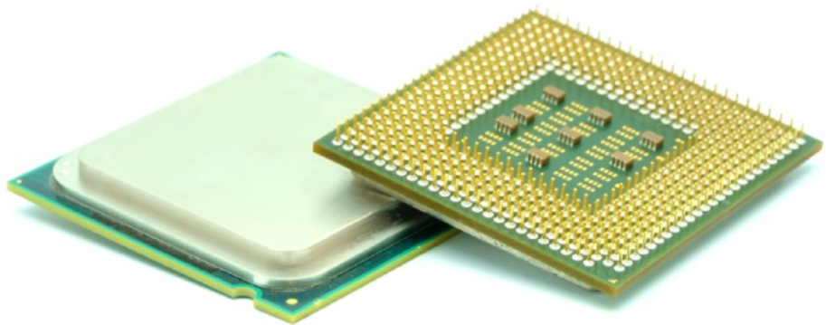
CPU Architectures and Operation CPU Architectures
A program is a sequence of stored instructions and a CPU executes these instructions by following a specific instruction set.
There are two distinct types of instruction sets that CPUs may use:
Reduced Instruction Set Computer (RISC) - This architecture uses a relatively small set of instructions. RISC chips are designed to execute these instructions very rapidly.
Complex Instruction Set Computer (CISC) - This architecture uses a broad set of instructions, resulting in fewer steps per operation.
While the CPU is executing one step of the program, the remaining instructions and the data are stored nearby in a special, high-speed memory, called cache.
Notes:
3.3 – Advanced Computer Functionality
3.3.1 – CPU Architectures and Operation
3.3.1.1 – CPU Architectures

Slide 37
CPU Architectures and Operation Enhancing CPU Operation
Intel processors use Hyper-Threading to enhance the performance of some of their CPUs.
With Hyper-Threading, multiple pieces of code (threads) are executed simultaneously in the CPU so a single CPU performs as though there are two CPUs.
AMD processors use HyperTransport to enhance CPU performance.
HyperTransport is a high-speed connection between the CPU and the Northbridge chip.
The power of a CPU is measured by the speed and the amount of data that it can process.
The speed of a CPU is rated in cycles per second, such as millions of cycles per second, called megahertz (MHz), or billions of cycles per second, called gigahertz (GHz).
The amount of data that a CPU can process at one time depends on the size of the front side bus (FSB).
Notes:
3.3 – Advanced Computer Functionality
3.3.1 – CPU Architectures and Operation
3.3.1.2 – Enhancing CPU Operation

Slide 38
CPU Architectures and Operation Enhancing CPU Operation (Cont.)
Overclocking is a technique used to make a processor work at a faster speed than its original specification.
Overclocking is not a recommended way to improve computer performance and can result in damage to the CPU.
The opposite of overclocking is CPU throttling.
CPU throttling is a technique used when the processor runs at less than the rated speed to conserve power or produce less heat.
CPU virtualization is a hardware feature supported by AMD and Intel CPUs that enables a single processor to act as multiple processors.
With CPU virtualization multiple operating systems can run in parallel on their own virtual machines as if they were running on completely independent computers.
Notes:
3.3 – Advanced Computer Functionality
3.3.1 – CPU Architectures and Operation
3.3.1.2 – Enhancing CPU Operation

Slide 39
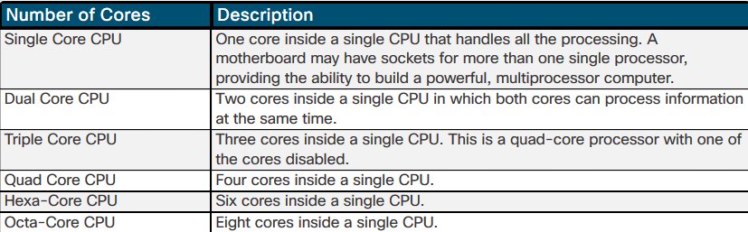
CPU Architectures and Operation Multicore Processors
Multicore processors have two or more processors on the same integrated circuit.
Integrating the processors on the same chip creates a very fast connection between them.
Multicore processors execute instructions more quickly than single-core processors. Instructions can be distributed to all the processors at the same time.
RAM is shared between the processors because the cores reside on the same chip.
Multicore processors conserve power and produce less heat than multiple single-core processors, thus increasing performance and efficiency.
Notes:
3.3 – Advanced Computer Functionality
3.3.1 – CPU Architectures and Operation
3.3.1.3 – Multicore Processors

Slide 40
CPU Architectures and Operation Multicore Processors (Cont.)
Another feature found in some CPUs is an integrated graphics processing unit or GPU.
The GPU is a chip that performs the rapid mathematical calculations required to render graphics.
A GPU can be integrated or dedicated.
Integrated GPUs are often directly embedded on the CPU and is dependent on system RAM while the dedicated GPU is a separate chip with its own video memory dedicated exclusively for graphical processing.
The benefit of integrated GPUs is cost and less heat dissipation.
Integrated GPUs are good at less complex tasks like watching videos and processing graphical documents but are not best suited for intense gaming applications.
Notes:
3.3 – Advanced Computer Functionality
3.3.1 – CPU Architectures and Operation
3.3.1.3 – Multicore Processors

Slide 41
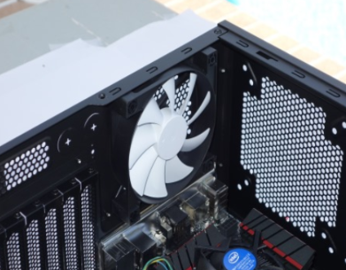
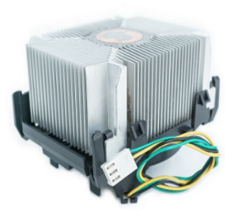
CPU Architectures and Operation CPU Cooling Mechanisms
Case Fan
A case fan is used to increase the air flow in the computer case and allows more heat to be removed.
Some cases have multiple fans with cool air being brought in, while another fan is blowing out hot air.
CPU Heat Sink
A heat sink has a large surface area with metal fins in order to draw heat away from the CPU and dissipate it into the surrounding air.
Thermal compound is placed between the heat sink and the CPU to increase the efficiency of heat transfer.
A CPU heat sink without a fan is known as “passive cooling”.
Notes:
3.3 – Advanced Computer Functionality
3.3.1 – CPU Architectures and Operation
3.3.1.4 – CPU Cooling Mechanisms

Slide 42
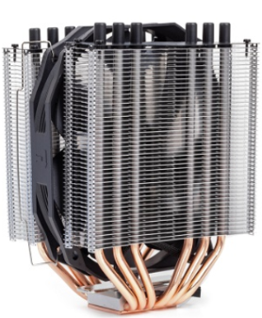
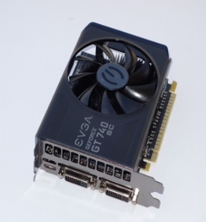
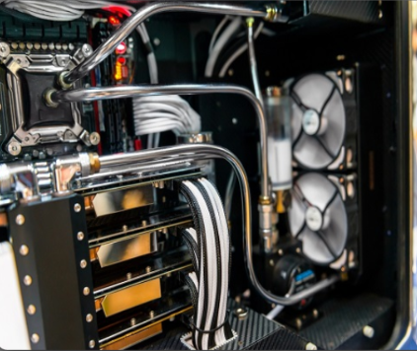
CPU Architectures and Operation CPU Cooling Mechanisms (Cont.)
CPU Fan
It is common to install a fan on top or within a heat sink in order to move heat away from the metal fins.
A CPU heat sink with a fan is known as “active cooling”.
Graphics Card Cooling System
Video adapter cards have a graphics=processing Unit (GPU) that generates excessive heat.
Water Cooling System
A metal plate is placed over the processor and water is pumped over the top to collect the heat the processor generates.
The water is pumped to a radiator to disperse the heat into the air and then the water is recirculated.
Notes:
3.3 – Advanced Computer Functionality
3.3.1 – CPU Architectures and Operation
3.3.1.4 – CPU Cooling Mechanisms
3.3.1.5 – Check Your Understanding – CPU Architectures and Operation

Slide 43
RAID RAID Concepts
Computers can implement redundant array of independent disks (RAID) technology.
RAID provides a way to store data across multiple storage devices for availability, reliability, capacity, and redundancy and/or performance improvement
The following terms describe how RAID stores data on the various disks:
Striping – enables data to be distributed across multiple drives with a significant performance increase, however the failure of a single drive means that all data is lost.
Mirroring – stores duplicate data on one or more other drives and provides redundancy so that the failure of a drive does not cause the loss of data.
Parity – provides basic error checking and fault tolerance by storing checksums separately from data and enables the reconstruction of lost data without sacrificing speed and capacity.
Double Parity – provides fault tolerance for up to two failed drives.
Notes:
3.3 – Advanced Computer Functionality
3.3.2 – RAID
3.3.2.1 – What Do You Already Know? - RAID
3.3.2.2 – RAID Concepts

Slide 44
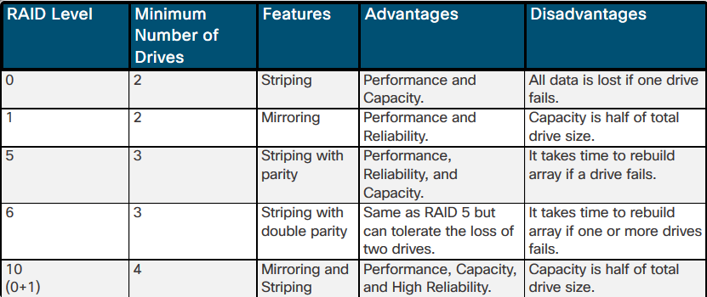
RAID RAID Levels
There are several levels of RAID available.
These levels use mirroring, striping, and parity in different ways.
Higher levels of RAID, such as RAID 5 or 6, use striping and parity in combination to provide speed and to create large volumes.
RAID levels higher than 10 combine lower RAID levels.
Notes:
3.3 – Advanced Computer Functionality
3.3.2 – RAID
3.3.2.3 – RAID Levels
3.3.2.4 – Check Your Understanding – RAID Levels

Slide 45
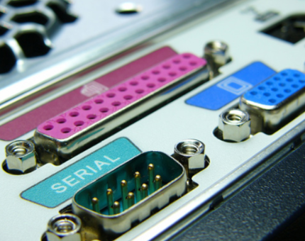
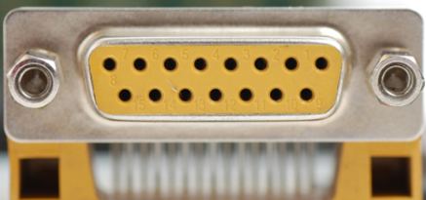
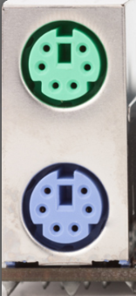

Ports, Connectors, and Cables Legacy Ports
Serial
Used for connecting various peripherals such as printers, scanners, modems, and console connections to network devices.
Parallel
Used for connecting to various peripheral devices, commonly printers.
Game
Used for connecting a joystick input
PS/2
Used for connecting a keyboard and mouse. Purple for keyboard and green for the mouse.
Audio ports
Analog ports were used for connecting stereo system, microphone and speakers/headphones.
Notes:
3.3 – Advanced Computer Functionality
3.3.3 – Ports, Connectors, and Cables
3.3.3.1 – Legacy Ports

Slide 46
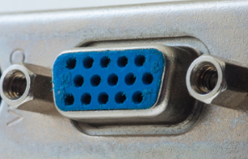
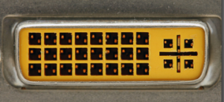
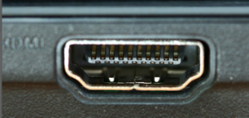
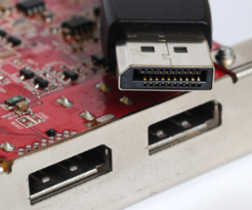
Ports, Connectors, and Cables Video and Graphic Ports
VGA
An analog port and commonly the oldest graphics port still used on some PCs.
DVI
Provides support for transmitting uncompressed digital video.
Includes DVI-A (analog), DVI-D (digital), and DVI-I (integrated).
HDMI
Carries the same video information as DVI but is also capable of providing digital audio and control signals..
DisplayPort
Designed to replace both DVI and VGA for computer monitors while including high bandwidth video and audio signals.
Notes:
3.3 – Advanced Computer Functionality
3.3.3 – Ports, Connectors, and Cables
3.3.3.2 – Video and Graphic Ports

Slide 47
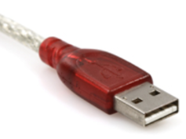
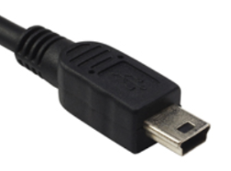
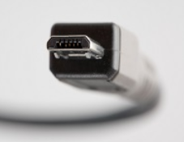
Ports, Connectors, and Cables USB Cables and Connectors
Over the years, USB has evolved with various standards. (USB 1.0, USB 2.0, USB 3.0, and USB 3.2)
USB Type-A
The typical rectangular connector found on almost all desktop and laptop computers, TVs, game consoles, and media players.
Mini-USB
A rectangular connector with a small indention on each side that is being replaced with the micro-USB connector.
Micro-USB
A common connector on smartphones, tablets and other devices.
This connector has two corners pushed in at an angle.
Notes:
3.3 – Advanced Computer Functionality
3.3.3 – Ports, Connectors, and Cables
3.3.3.3 – USB Cables and Connectors

Slide 48
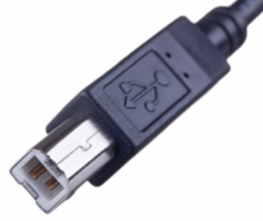
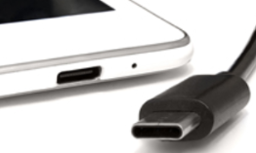
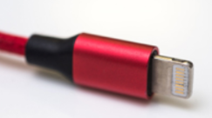
Ports, Connectors, and Cables USB Cables and Connectors (Cont.)
USB Type-B
This connector has a square shape with beveled exterior corners and an extra notch at the top.
Used to connect printers or external hard drives.
USB Type-C
This connector is rectangular with four rounded corners and is the newest USB interface.
Used as a multipurpose cable to attach different kinds of peripheral devices to a PC.
Lightning
This connector is a small proprietary 8-pin connector used by Apple mobile devices such as iPhones, iPads, and iPods for both power and data.
Notes:
3.3 – Advanced Computer Functionality
3.3.3 – Ports, Connectors, and Cables
3.3.3.3 – USB Cables and Connectors

Slide 49
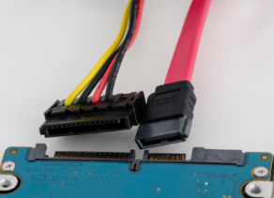
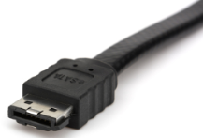
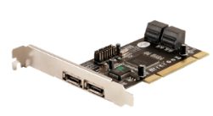
Ports, Connectors, and Cables SATA Cables and Connectors
SATA Cable
One end plugs into a SATA port on a motherboard and the other end into the back of an internal storage device.
The SATA data cable does not provide power so a SATA power cable is needed in addition to power the internal storage device.
SATA data and power cables are keyed so they can only be installed in one way.
eSATA Cable
This cable is used to connect external SATA drives and is a keyed connector.
eSATA Adapter
An expansion card is commonly used to provide eSATA ports.
Notes:
3.3 – Advanced Computer Functionality
3.3.3 – Ports, Connectors, and Cables
3.3.3.4 – SATA Cables and Connectors

Slide 50
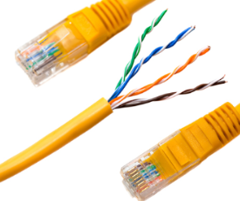
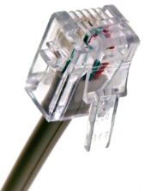
Ports, Connectors, and Cables Twisted Pair Cables and Connectors
Twisted pair cable is used in wired Ethernet networks and older telephone networks.
Twisted Pairs
Unshielded Twisted Pair (UTP) cabling is the most common form of twisted pair cabling and uses color-coded insulated copper wires.
Shielded Twisted Pair (STP) also uses color-coded insulated copper wires but includes foil or braiding as well.
RJ-45
Each end of a UTP cable must be terminated with an RJ-45 connector so it can be plugged into an Ethernet port.
RJ-11
Older telephone networks used a four-wire UTP cable terminated with an RJ-11 connector.
Notes:
3.3 – Advanced Computer Functionality
3.3.3 – Ports, Connectors, and Cables
3.3.3.5 – Twisted Pair Cables and Connectors

Slide 51
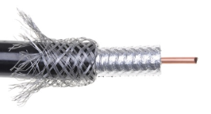
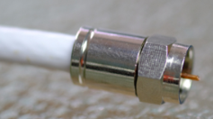
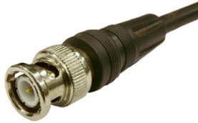
Ports, Connectors, and Cables Coax Cables and Connectors
Coax Cable Construction
Coaxial cable has an inner center conductor surrounded by insulating material.
The insulating material is surrounded by a foil shield which is used as an outer conductor and also shields against electromagnetic interference (EMI).
RG-6
A heavy gauge cable with insulation and shielding for high-bandwidth, high-frequency applications (Internet, Cable TV, and Satellite TV)
RG-59
A thinner cable similar to RG-6, used for low bandwidth and lower frequency applications (analog video and CCTV)
BNC
An older connector, used with digital or analog audio or video.
Notes:
3.3 – Advanced Computer Functionality
3.3.3 – Ports, Connectors, and Cables
3.3.3.6 – Coax Cables and Connectors

Slide 52
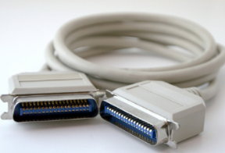
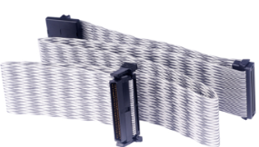
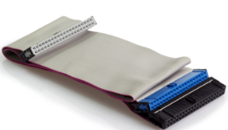
Ports, Connectors, and Cables SCSI and IDE Cables and Connectors
Small Computer Systems Interface (SCSI) is a standard for connecting peripheral and storage devices in a daisy-chained format.
External SCSI Cable
Used for connecting older external SCSI devices (scanners and printers).
Internal SCSI Cable
Common SCSI connector for internal hard drives with 50 pins arranged in two rows and attached to a ribbon cable.
IDE Cable
Visually similar to the internal SCSI cable, but commonly with three 40-pin connectors.
One connector connects to the IDE port on the motherboard and two for attaching IDE drives.
Notes:
3.3 – Advanced Computer Functionality
3.3.3 – Ports, Connectors, and Cables
3.3.3.7 – SCSI and IDE Cables and Connectors
3.3.3.8 – Check Your Understanding – Ports, Connectors, and Cables

Slide 53
Monitors Monitor Characteristics
There are many types of computer monitors available and they vary by use, size, quality, clarity, brightness and more.
Computer monitors are usually described by:
Screen size – The diagonal measurement of the screen (i.e., top left to bottom right) in inches.
Resolution – Resolution is measured by the number of horizontal and vertical pixels. For example, 1920 x 1080 (i.e., 1080p) means it has 1920 horizontal pixels and 1080 vertical pixels.
Monitor resolution – This relates to the amount of information that can be displayed on a screen.
Native resolution – This identifies the best monitor resolution for the specific monitor.
Native mode – This term describes when the image sent to the monitor by the video adapter card matches the native resolution of the monitor.
Connectivity – Older monitors used VGA or DVI while newer monitors support HDMI and DisplayPort.
Notes:
3.3 – Advanced Computer Functionality
3.3.4 – Monitors
3.3.4.1 – Monitor Characteristics

Slide 54
Monitors Monitor Terms
Pixel – a tiny dot capable of displaying red, green, and blue.
Dot pitch – The distance between pixels on the screen.
Brightness – The luminance of a monitor, measured in candelas per square meter (cd/m2)
Contrast ratio – The measurement of how white and how black a monitor can get.
Aspect ratio – The horizontal to vertical measurement of the viewing area of a monitor.
Refresh rate – The amount of seconds for an image to be rebuilt, measured in Hertz (Hz).
Response time - The amount in time for a pixel to change properties (color or brightness)
Interlaced – Creates an image by scanning the screen two times. (Odd lines and then even lines)
Non-Interlaced – Creates an image by scanning the screen one line at a time, from top to bottom.
Notes:
3.3 – Advanced Computer Functionality
3.3.4 – Monitors
3.3.4.2 – Monitor Terms

Slide 55
Monitors Display Standards
CGA – Color Graphics Adapter (320 x 200 resolution)
VGA – Video Graphics Array (640 x 480 resolution)
SVGA – Super Video Graphics Array ( 800 x 600 resolution)
HD – High Definition (1280 x 720 resolution) – Also known as 720p
FHD – Full High Definition (1920 x 1280 resolution) – Also known as 1080p
QHD – Quad High Definition (2560 x 1440 resolution) – Also known as 1440p
UHD – Ultra High Definition ( 3840 x 2160 resolution) – Also known as 4k
Notes:
3.3 – Advanced Computer Functionality
3.3.4 – Monitors
3.3.4.3 – Display Standards

Slide 56

Monitors Using Multiple Monitors
Adding monitors can increase your visual desktop area and improve productivity.
The added monitors enable you to expand the size of the monitor or duplicate the desktop so you can view additional windows.
Many computers have built-in support for multiple monitors.
To connect multiple monitors to a computer, you need to:
enable your computer to support multiple monitors
gather the appropriate display cables
Notes:
3.3 – Advanced Computer Functionality
3.3.4 – Monitors
3.3.4.4 – Using Multiple Monitors
3.3.4.5 – Check Your Understanding – Monitor Terminology

Slide 57
3.4 Computer Configuration
Notes:
3 – Advanced Computer Hardware
3.4 – Computer Configuration

Slide 58
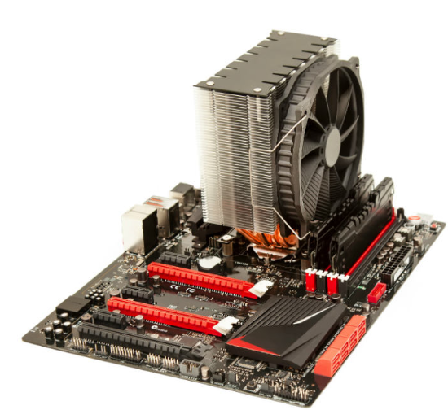
Upgrade Computer Hardware Motherboard Upgrade
Computers need periodic upgrades for various reasons:
User requirements change
Upgraded software packages require new hardware
New hardware offers enhanced performance
If you upgrade or replace a motherboard, consider that you might have to replace other components including:
CPU
heat sink and fan assembly
RAM.
A new motherboard must fit in the old computer case and the power supply must support it.
Notes:
3.4 – Computer Configuration
3.4.1 – Upgrade Computer Hardware
3.4.1.1 – Motherboard Upgrade

Slide 59
Upgrade Computer Hardware Steps to Upgrade a Motherboard
To upgrade a motherboard from a computer case, follow these steps:
Step 1. Record how the power supply, case fans, case LEDs, and case buttons attach to the old motherboard.
Step 2. Disconnect the cables from the old motherboard.
Step 3. Disconnect and remove the expansion cards from the case.
Step 4. Record how the old motherboard is secured to the case.
Step 5. Remove the old motherboard from the case.
Step 6. Identify where all of the connectors are such as power, SATA, fan, USB, audio, front panel connector, and any others on the new motherboard.
Step 7. Replace the old I/O shield with the new I/O shield.
Step 8. Insert and secure the motherboard into the case.
Step 9. Connect the power supply, case fans, case LEDs, front panel, and any other required cables.
Step 10. After the new motherboard is in place and the cables are connected, install and secure the expansion cards.
Notes:
3.4 – Computer Configuration
3.4.1 – Upgrade Computer Hardware
3.4.1.2 – Steps to Upgrade a Motherboard

Slide 60
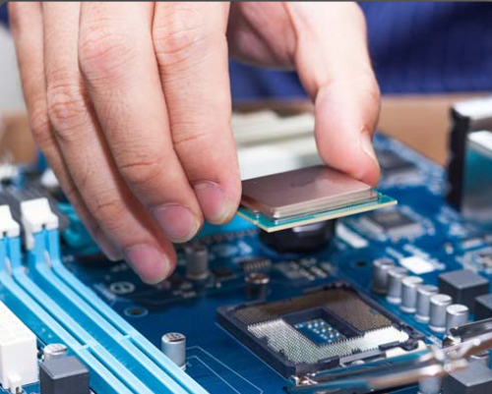
Upgrade Computer Hardware CPU Upgrade
One way to increase the power of a computer is to increase the processing speed by upgrading the CPU.
The new CPU might require a different heat sink and fan assembly.
The assembly must physically fit the CPU and be compatible with the CPU socket.
It must also be adequate to remove the heat of the faster CPU by installing additional case fans.
CAUTION: You must apply thermal compound between the new CPU and the heat sink and fan assembly.
Notes:
3.4 – Computer Configuration
3.4.1 – Upgrade Computer Hardware
3.4.1.3 – CPU Upgrade

Slide 61
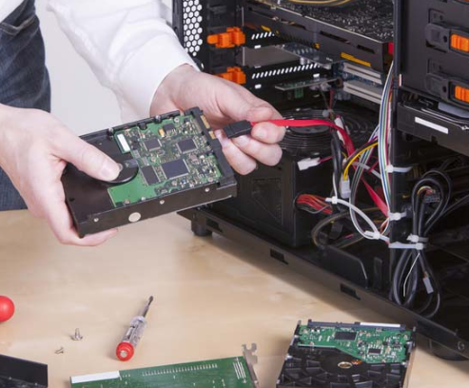
Upgrade Computer Hardware Storage Device Upgrade
After selecting the appropriate hard drive, follow these general guidelines during installation:
Step 1. Place the hard drive in an empty drive bay, and tighten the screws to secure the hard drive.
Step 2. Connect the drive to the motherboard using the correct cable.
Step 3. Attach the power cable to the drive.
Instead of purchasing a new computer to get faster speed and more storage space, you might consider adding another hard drive.
There are several reasons for installing an additional drive:
Increase storage space
Increase hard drive speed
Install a second operating system
Store the system swap file
Provide fault tolerance
Back up the original hard drive
Notes:
3.4 – Computer Configuration
3.4.1 – Upgrade Computer Hardware
3.4.1.4 – Storage Device Upgrade

Slide 62
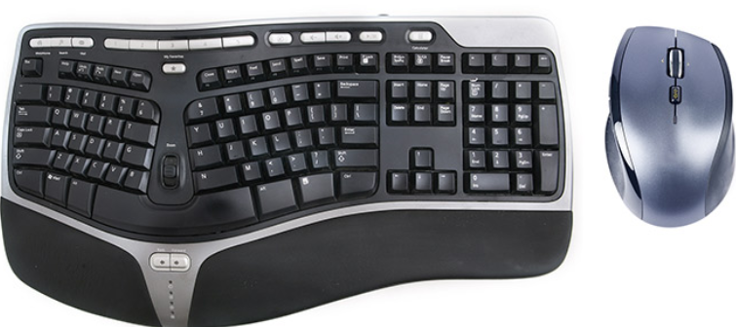
Upgrade Computer Hardware Peripheral Upgrades
Peripheral devices periodically need to be upgraded.
For example, if the device stops operating or if you wish to improve performance and productivity, an upgrade might be necessary.
These are a few reasons for upgrading a keyboard and/or a mouse:
Change the keyboard and mouse to an ergonomic design
Ergonomic devices are made to be more comfortable to use and to help prevent repetitive motion injuries.
Reconfigure the keyboard to accommodate a special task, such as typing in a second language with additional characters.
To accommodate users with disabilities.
Notes:
3.4 – Computer Configuration
3.4.1 – Upgrade Computer Hardware
3.4.1.5 – Peripheral Upgrades

Slide 63
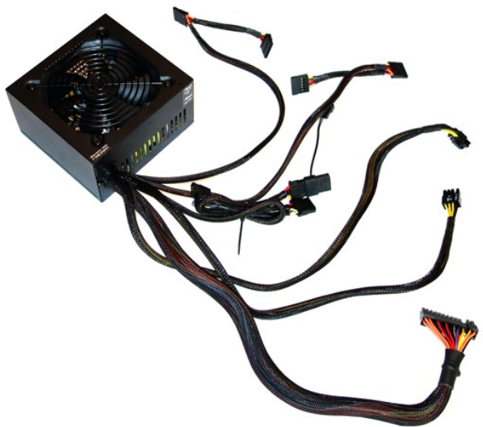
Upgrade Computer Hardware Power Supply Upgrade
Upgrading your computer hardware will most likely also change its power needs.
If so, you may need to upgrade your power supply.
You can find calculators on the internet to help you determine if you need to upgrade the power supply.
Search for “power supply wattage calculator”.
Notes:
3.4 – Computer Configuration
3.4.1 – Upgrade Computer Hardware
3.4.1.6 – Power Supply Upgrade

Slide 64
Upgrade Computer Hardware Lab – Research a Hardware Upgrade
In this lab, you will gather information about hardware components so you can upgrade your customer’s hardware so they can play advanced video games.
Notes:
3.4 – Computer Configuration
3.4.1 – Upgrade Computer Hardware
3.4.1.7 – Lab - Research a Hardware Upgrade

Slide 65
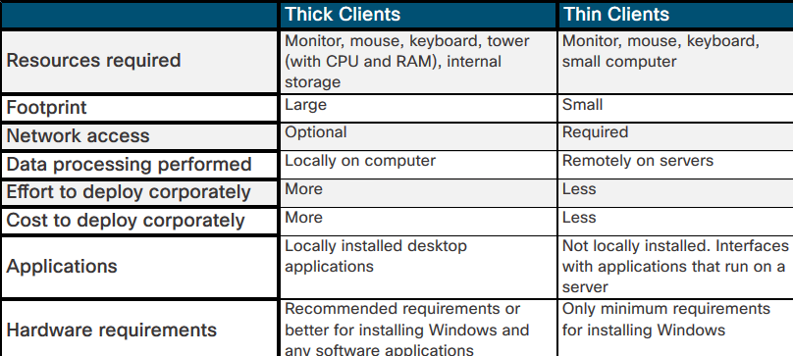
Configurations for Specialized Computers Thick and Thin Clients
Computers are sometimes referred to as:
Thick clients
Sometimes called fat clients
Standard computers with their own operating system, a multitude of applications, and local storage.
They are stand-alone systems and do not require a network connection to operate, as all of the processing is performed locally on the computer.
Thin clients
Typically low-end network computers that rely on remote servers to perform all data processing.
Thin clients require a network connection to a server and usually access resources using a web browser
Typically the clients do not have any internal storage and have very little local resources.
Notes:
3.4 – Computer Configuration
3.4.2– Configurations for Specialized Computers
3.4.2.1 – What Do You Already Know? – Configure an CAx Workstation
3.4.2.2 – What Do You Already Know? – Configure an Audio Video Editing Workstation
3.4.2.3 – What Do You Already Know? – Configure a Virtualization Workstation
3.4.2.4 – What Do You Already Know? – Configure a Gaming PC
3.4.2.5 – Check Your Understanding – Specialized Computer Component Types
3.4.2.6 – Thick and Thin Clients

Slide 66
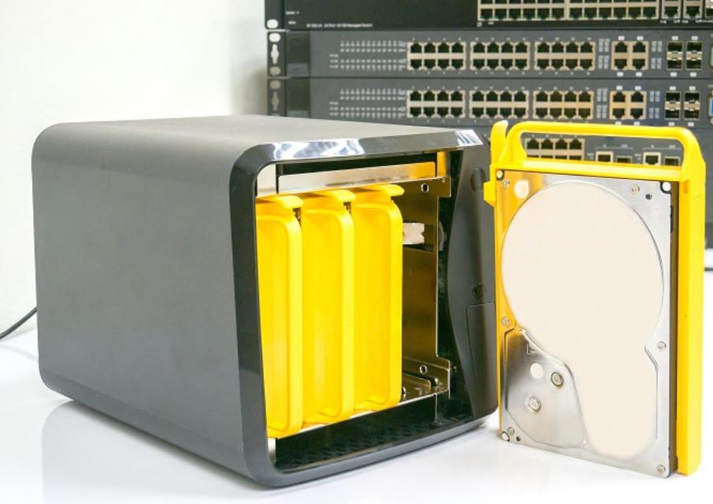
Configurations for Specialized Computers NAS
Network attached storage (NAS) devices are servers that are connected to a network to provide file-level data storage to clients.
This specialized computer is sometimes single-purposed, running a stripped-down operating system to perform only the function of file serving.
Sometimes the device can offer additional functionality such as:
media streaming
network services
automated backup functions
website hosting and more...
Notes:
3.4 – Computer Configuration
3.4.2– Configurations for Specialized Computers
3.4.2.7 – NAS

Slide 67
3.5 Protecting the Environment
Notes:
3 – Advanced Computer Hardware
3.5 – Protecting the Environment

Slide 68
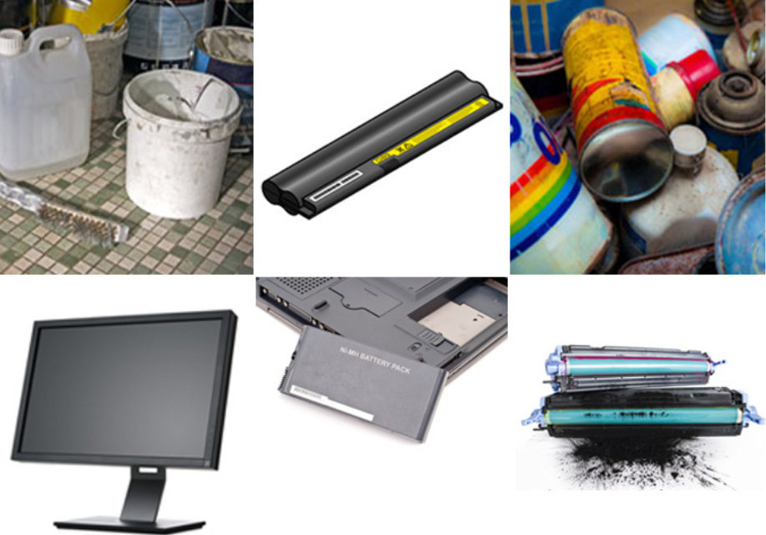
Safe Disposal of Equipment and Supplies Safe Disposal Methods
The proper disposal or recycling of hazardous computer components is a global issue.
Make sure to follow regulations that govern how to dispose of specific items.
Organizations that violate these regulations can be fined or face expensive legal battles.
Regulations for the disposal of these items vary from state to state and from country to country:
Batteries
Toner Kits, Cartridges, and Developers
Chemical Solvents and Aerosol Cans
Cell Phones and tablets
Notes:
3.5 – Protecting the Environment
3.5.1 – Safe Disposal of Equipment and Supplies
3.5.1.1 – Safe Disposal Methods

Slide 69
Safe Disposal of Equipment and Supplies Safety Data Sheets
A Safety Data Sheet (SDS), formerly known as a Material Safety and Data Sheet (MSDS), is a fact sheet that summarizes information about material identification, including hazardous ingredients that can affect personal health, fire hazards, and first-aid requirements.
The SDS contains chemical reactivity and incompatibility information.
It also includes protective measures for the safe handling and storage of materials and spill, leak, and disposal procedures.
To determine if a material is classified as hazardous, consult the manufacturer’s SDS which in the U.S. is required by OSHA when the material is transferred to a new owner.
The SDS explains how to dispose of potentially hazardous materials in the safest manner.
Notes:
3.5 – Protecting the Environment
3.5.1 – Safe Disposal of Equipment and Supplies
3.5.1.2 – Safety Data Sheets
3.5.1.3 – Check Your Understanding: Safe Disposal

Slide 70
3.6 Chapter Summary
Notes:
3 – Advanced Computer Hardware
3.6 – Chapter Summary

Slide 71
Conclusion Chapter 3: Advanced Computer Hardware
Configure BIOS and UEFI settings
Explain electrical power
Explain computer functionality
Describe monitor characteristics.
Explain safe disposal methods to protect the environment
Notes:
3.6 – Chapter Summary
3.6.1 – Conclusion
3.6.1.1 – Chapter 3: Advanced Computer Hardware

Slide 72
Section 3.1 New Terms and Commands
BIOS UEFI POST CMOS | Secure Boot LoJack TPM Flashing the BIOS
Notes:
New Terms and Commands

Slide 73
Section 3.2 New Terms and Commands
Voltage Resistance Current Power Surge Protector UPS SPS | Ohm’s Law Blackout Brownout Noise Spike Power Surge
Notes:
New Terms and Commands

Slide 74
Section 3.3 New Terms and Commands
RISC CISC HyperTransport Hyper-Threading MHz GHz CPU Virtualization GPU Multicore CPUs Water Cooling Active Cooling Passive Cooling Striping Mirroring Parity Double Parity | Raid Levels (0,1,5,6,10) Serial Parallel Game PS/2 VGA DVI HDMI DisplayPort USB Type-A Mini-USB Micro-USB USB Type-B USB Type-C Lightning
Notes:
New Terms and Commands

Slide 75
Section 3.3 New Terms and Commands (Cont.)
SATA eSATA RJ-45 RJ-11 UTP STP RG-6 RG-59 BNC SCSI IDE Pixel Dot Pitch Brightness Contrast Ratio | Aspect Ratio Refresh Rate Response Time Interlaced Non-Interlaced CGA VGA SVGA HD FHD QHD UHD
Notes:
New Terms and Commands

Slide 76
Section 3.4 New Terms and Commands
Ergonomic CAx CAM VDI | Thin Client Thick Client Fat Client NAS
Notes:
New Terms and Commands

Slide 77
Section 3.5 New Terms and Commands
SDS | MSDS
Notes:
New Terms and Commands

